Slide 1
AC Signal
Dr. Michael Nasief

Slide 2
Sinusoidal Waveform

Slide 3
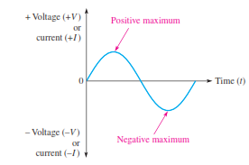
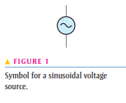
Signal Generators
Rotating electrical machines (ac generators)
Electronic oscillator circuits

Slide 4
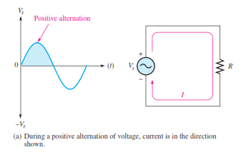
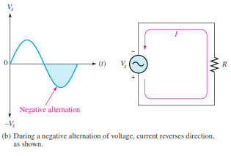
Polarity of a Sine Wave
it alternates between positive and negative values

Slide 5
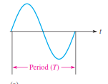
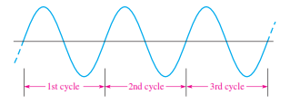
Period of a Sine Wave
The time required for a sine wave to complete one full cycle is called the period (T).

Slide 6
Example

Slide 7
Example

Slide 9
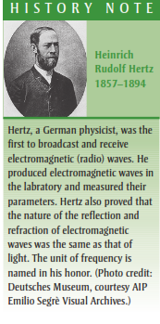
Frequency of a Sine Wave
Frequency (f ) is the number of cycles that a sine wave completes in one second.

Slide 10
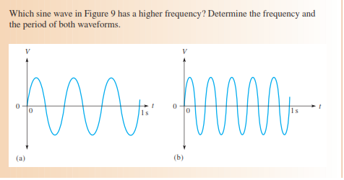
Example

Slide 13
Electronic Signal Generators
The signal generator is an instrument that electronically produces sine waves for use in testing or controlling electronic circuits and systems. There are a variety of signal generators, ranging from special-purpose instruments that produce only one type of waveform in a limited frequency range, to programmable instruments that produce a wide range of frequencies and a variety of waveforms. All signal generators consist basically of an oscillator, which is an electronic circuit that produces repetitive waves. All generators Have controls for adjusting the amplitude and frequency.

Slide 14
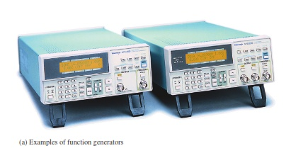
Function Generators and Arbitrary Waveform Generators
A function generator is
an instrument that produces more than one type of waveform. It provides pulse waveforms as well as sine waves and triangular waves.

Slide 15
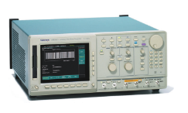
An arbitrary waveform generator
An arbitrary waveform generator can be used to generate standard signals like sine waves, triangular waves, and pulses as well as signals with various shapes and characteristics. Waveforms can be defined by mathematical or graphical input (special Case)

Slide 17
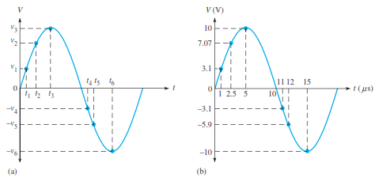
Instantaneous Value
Instantaneous values of voltage and current are symbolized by lowercase v and i, respectively.

Slide 18
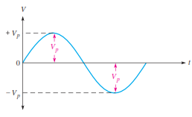
Peak Value
The peak value of a sine wave is the value of voltage (or current) at the positive or the negative maximum (peak) with respect to zero.

Slide 19
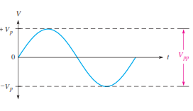
Peak-to-Peak Value

Slide 20
RMS Value
The term rms stands for root mean square. Most ac voltmeters display rms voltage. The
220 V at your wall outlet is an rms value. The rms value, also referred to as the effective
value,

Slide 21
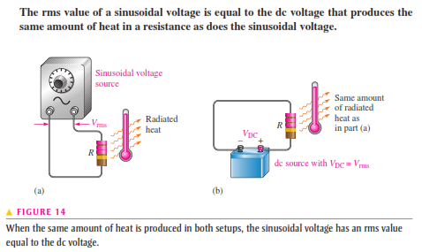
Why RMS ?

Slide 22
RMS Equations

Slide 23
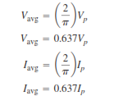
Average Value
The average value of a sine wave taken over one complete cycle is always zero because the positive values (above the zero crossing) offset the negative values (below the zero crossing) are equal.
The average value is the total area under the half-cycle curve divided by the distance in radians of the curve along the horizontal axis.

Slide 25
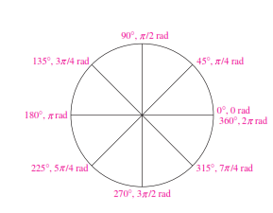
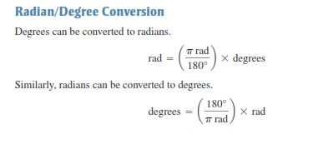
ANGULAR MEASUREMENT OF A SINE WAVE

Slide 27
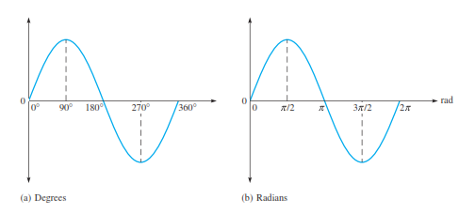
Sine Wave Angles

Slide 28
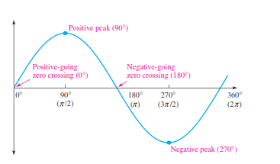
Phase of a Sine Wave
The phase of a sine wave is an angular measurement that specifies the position of that sine wave relative to a reference.

Slide 31
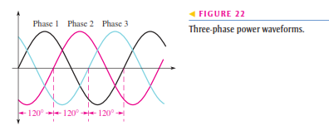
Polyphase Power

Slide 32
Assignment 1
Research on the effect of AC and DC on Human body
Only in no more than 3 papers.
Next week only

